Slide 1
Using OpenCV for Face Recognition
Notes:
In this video, we’ll explore how the capabilities provided in OpenCV can give us a more state-of-the-art face recognition solution.

Slide 2
What we will cover in this module
What does OpenCV give us out of the box?
How can we use OpenCV to detect faces in images
What do we need to do to recognize faces
Notes:
This slide, like mentioned above is for multiple pointers. The information above covers the types of information that can be used in this slide

Slide 3

What does OpenCV provide?
OpenCV is a toolbox of computer vision algorithms
Pre-trained Caffe model to identify faces in an image
OpenCV’s deep learning face detector is based on the Single Shot Detector (SSD) framework with a ResNet base network
0.38548, 0.9345, 0.2435, 0.547675, 0.34546, 0.6325, 0.46456, 0.155092, 0.35469, 0.24352, 0.97879, 0.39548…
0.38548, 0.9345, 0.2435, 0.547675, 0.34546, 0.6325, 0.46456, 0.155092, 0.35469, 0.24352, 0.97879, 0.39548…
0.38548, 0.9345, 0.2435, 0.547675, 0.34546, 0.6325, 0.46456, 0.155092, 0.35469, 0.24352, 0.97879, 0.39548…
Mark 87.3%
0.38548, 0.9345, 0.2435, 0.547675, 0.34546, 0.6325, 0.46456, 0.155092, 0.35469, 0.24352, 0.97879, 0.39548…
0.38548, 0.9345, 0.2435, 0.547675, 0.34546, 0.6325, 0.46456, 0.155092, 0.35469, 0.24352, 0.97879, 0.39548…
0.38548, 0.9345, 0.2435, 0.547675, 0.34546, 0.6325, 0.46456, 0.155092, 0.35469, 0.24352, 0.97879, 0.39548…
Face Detection
Feature Extraction
Feature Matching
Image
Notes:
OpenCV provides a toolbox of computer vision algorithms. These tools enable us to both manipulate images and identify features in images. It provides a pre-trained Caffe module for detecting faces, and the ability to extract features for these faces using a pre-trainined OpenFace deep neural network.
In this approach, we will use OpenCV’s face detector to detect faces in the image, and then use the OpenFace feature extractor to extract features from our face. As this is a deep neural network, we don’t know exactly what the features mean but we can see that we get a 128-feature vector that is unique for each face.
We can then use this to find the highest probability match in our known faces. For this we’ll use a Support Vector Machine (or SVM).
This will work well with a small number of faces. During development of this course, I tried it with several thousand faces and initial results were not very good. For a more complex problem like recognizing thousands of faces, we’d need to introduce a more complex approach such as another neural network.

Slide 4
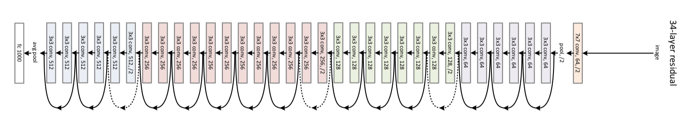
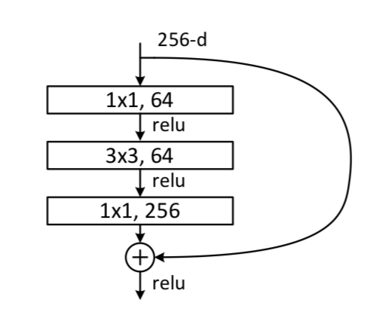
ResNet Architecture
Example of a ResNet Building Block
arXiv:1512.03385v1 [cs.CV]
Notes:
ResNet is a Deep Residual Network.
A residual neural network is an artificial neural network (ANN) of a kind that builds on constructs known from pyramidal cells in the cerebral cortex^{[citation needed]}. Residual neural networks do this by utilizing skip connections or short-cuts to jump over some layers.

Slide 5
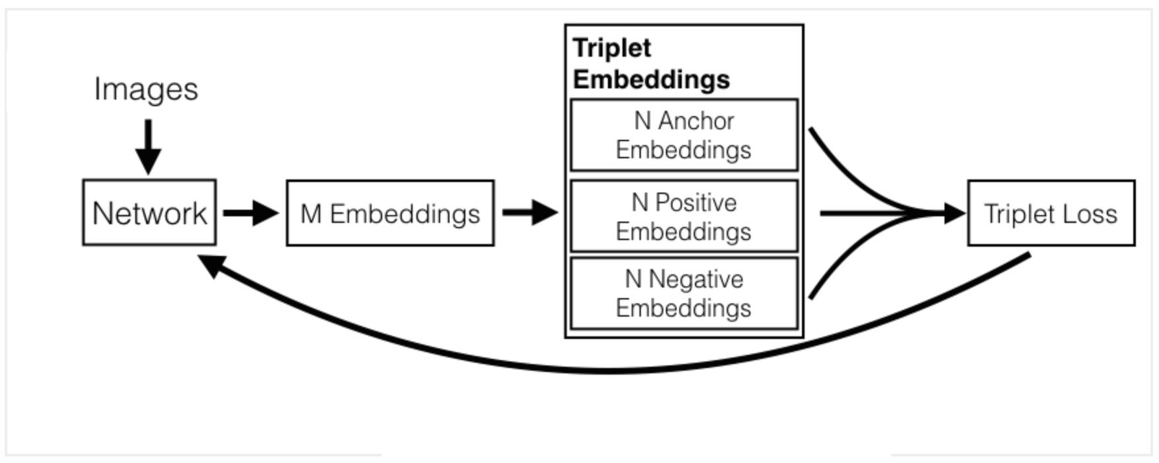
OpenFace Architecture
Source: http://bamos.github.io/2016/01/19/openface-0.2.0/
Notes:
OpenFace is a Python and Torch implementation of face recognition with deep neural networks and is based on the CVPR 2015 paper FaceNet: A Unified Embedding for Face Recognition and Clustering by Florian Schroff, Dmitry Kalenichenko, and James Philbin at Google.
The network architecture is complex and the detail doesn’t fit well on a single slide. However, this gives you an overview of the high level architecture. In essence, OpenFace is trained using a Siamese model, where a the network learns to recognise the same-ness between 2 faces (the anchor and positive image), and the difference to a 3rd (the negative image).

Slide 6
Getting Started
Download requirements, for example by using
pip install requirements.txt
You’ll need Open CV3.4.3 or later (some functionality not available pre-version 3.4.2)
Download OpenCV pre-trained model weights and config and the OpenFace trained model.
bash download_opencv_face_detector.sh
Notes:
This module requires a set of Python modules, such as OpenCV. These are documented in requirements.txt so they can be easily installed, or you can choose to do this manually. In order for this to work, you’ll need to be working with OpenCV version 3.4.2 or later. This code was developed using OpenCV 3.4.3, which was the latest stable release at the time of writing.
You’ll also need to download the relevant OpenCV models, this can be done simply by running the bash download_opencv_face_detector.sh script in opencv_face_recognition folder

Slide 7
Let’s look at the code…
Notes:
Now let’s work through this example notebook showing how we can train OpenCV to recognize some images in our LFW dataset.

Slide 8
AWS Rekognition
Notes:
Now that we’ve seen OpenCV in action, the next video shows have we can use a leading industry alternative, AWS’s Rekognition.

